Slide 1
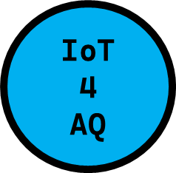


BUILDING THE IoT-BASED AIR SENSOR
INTERNATIONAL WORKHOP
AIR QUALITY & IoT-BASED AIR SENSORS
13-15 March, 2024
Uli Raich

Slide 2
Here are the steps …
Here is how to proceed:
The computer
Get to www.arduino.cc and download arduino SDK
Install different programs and libraries
Test the components separately
The ESP32 (GPIO, C++)
The DHT11
The LCD screen
The RTC module
The SD module
The PMS5003
API platform Thingspeak
Build the whole system
Add all components to the mCPU and in the main program one after another.

Slide 3

0. Your PC
Dear learner, welcome to this hands-on training!
You need a PC (with Linux or windows operating system).
Take out the components: µCPU, DHT11, LCD screen, wire, Type-C cable, etc.
A background in electronics and computer programming is necessary but not compulsory.
Check your internet connection before you start.

Slide 4

1. Resources and materials for the course

Slide 5
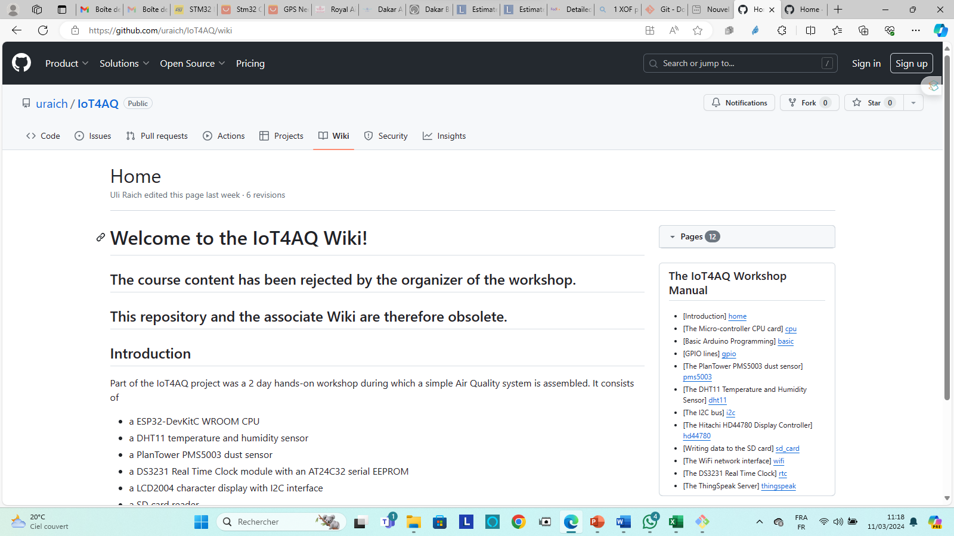
1. Resources & Materials
Resources and materials
Dear learner, the resources are found on Github…
- Documentations related to the course are on the wiki:
github.com/uraich/IoT4AQ/wiki

Slide 6
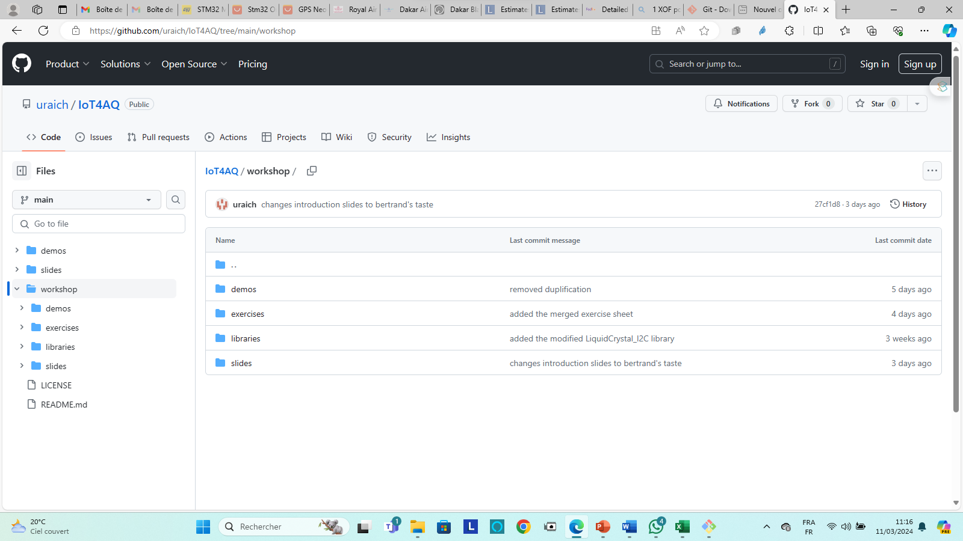
1. Resources & Materials
Resources and materials
Dear learner, the resources are found on Github…
- demo, exercises and solutions, libraries and slides are found here:
github.com/uraich/IoT4AQ/tree/main/workshop

Slide 7
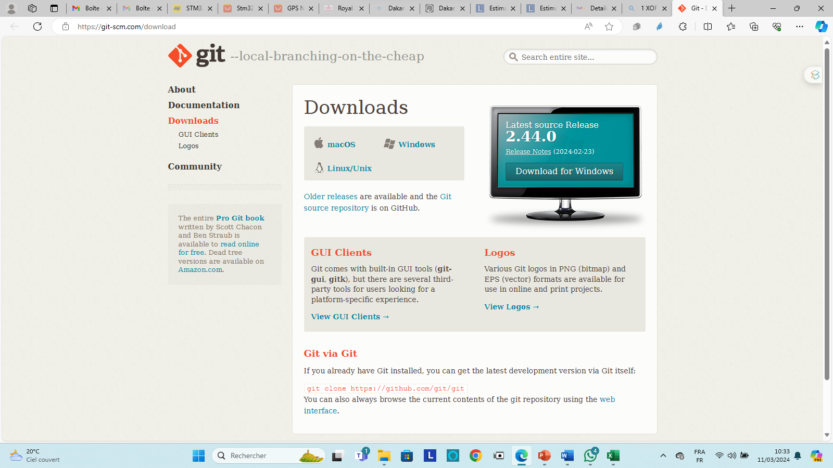
1. Resources & Materials
Git installation
Install git from https://git-scm.com/download

Slide 8
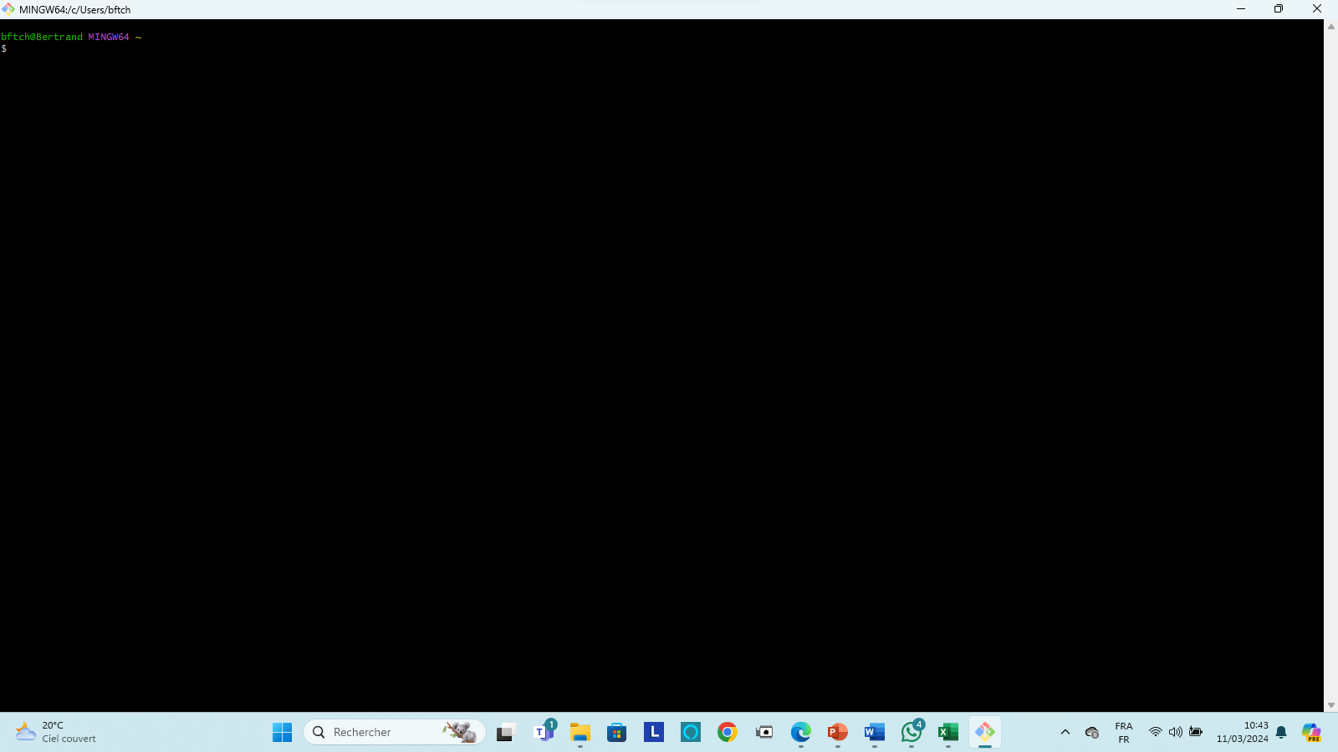
1. Resources & Materials
2. Git clone the IoT4AQ repository
Open the GitBash (if you are on windows)

Slide 9
1. Resources & Materials
3. Select the place where you want to install the folder
Do: cd c:/Users/your_username (this is an example)
Do: mkdir iot4aq (create the folder iot4aq)
Do: cd iot4aq
Do: git clone https://github.com/uraich/IoT4AQ.git

Slide 10
2. Install Programs

Slide 11
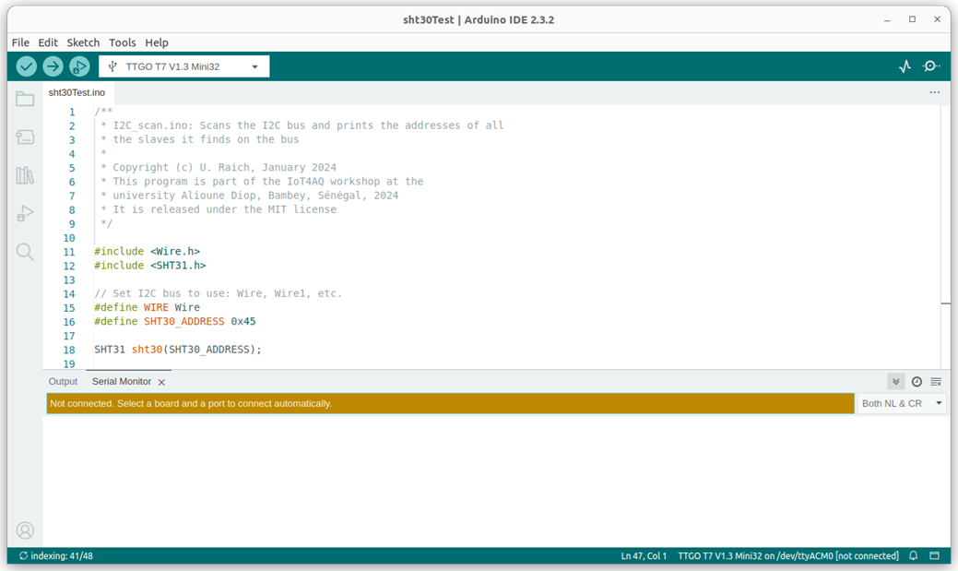
2. Install programs
Install on your computer: Arduino SDK (software development kit): https://www.arduino.cc/en/software There are versions for Linux, Windows, and Mac. Please use version 2.3.2 (latest version).
Run the SDK.

Slide 12
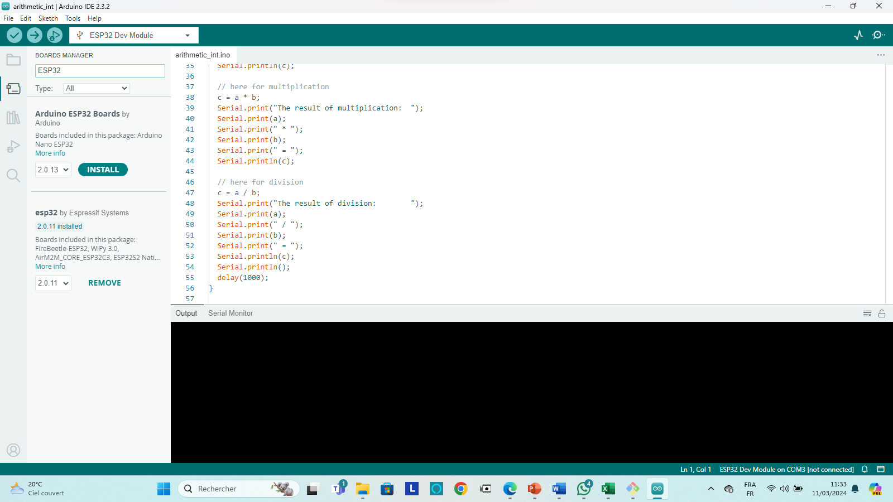
2. Install programs
Customization of SDK:
3. Install the ESP32 compiler and tools:
Tools → Board → Boards Manager
Type ESP32 in the filter field
select esp32 by Espressif (version 2.0.11) and proceed to its installation.

Slide 13

2. Install programs
Customization of SDK:
4. Install libraries:
DHT11 by Dhruba Saha
ESP32Time by fbiego
RTClib by Adafruit
ThingSpeak by Mathworks

Slide 14
2. Install programs
You are on SDK:
5. Install libraries: LIQUIDCrystal_I2C.zip and PMS5003.zip with:
Sketch → Include Library → Add .zip library
These 2 libraries are already in your github folder… IoT4AQ/workshop/libraries as zip files and install them using the instruction
Or you can download them from:
https://github.com/uraich/IoT4AQ/tree/main/workshop/libraries

Slide 15
3. Build the system

Slide 16
3. Course parts
1. ESP32
Basic C programming
General Purpose Input Output lines
2. Sensors
Temperature and humidity measurements: DHT11
Dust concentration: PMS5003
2. Local LCD display
I2C
Writing the display
3. SD card
Writing and reading files
4. Network
Connecting to the WiFI
5. Date and Time
RTC on the ESP32 and External battery backed RTC

Slide 17
3. Course parts
6. Network
ThingSpeak server
Registering on MathWorks
Creating a channel
Creating Charts and gauges
Sending results to ThingSpeak
7. Complete system

